Slide 1
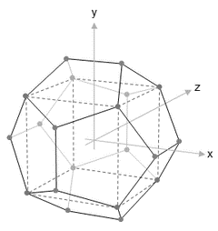
NISRA
Data Science Bootcamp
WELCOME
Course Title – Week 7 Python for Data Science
Course Tutor: Ashish Kumar
30th Jan – 3rd Feb 2017

Slide 2
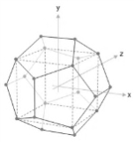
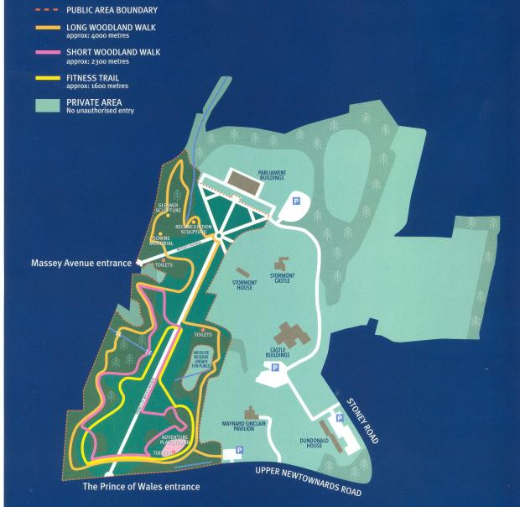
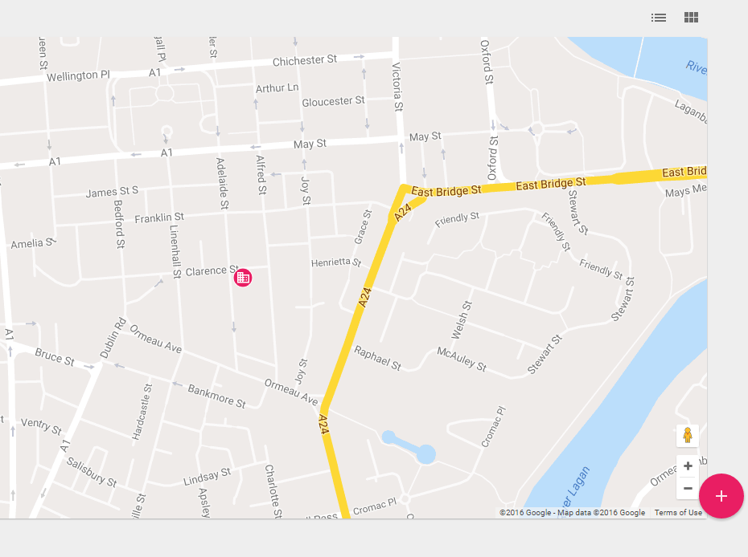
Course Locations
Location 1: ‘The Stables’, Stormont Castle
Location 2: ‘iD Lab’, Adelaide Street, Belfast

Slide 3
Your Attention Please
Fire Alarm
There are no fire alarm tests scheduled for today. So, if you do hear the fire alarm siren, or announcements asking you to leave the building, please leave immediately by the nearest available exit.
Staff in high visibility jackets will direct you to the assembly point.
Please take a moment to locate the exits around you now.
Toilets
The NISRA Stables Training Room toilets are located…..<to complete>
The Intelligent Datalytics toilets are located on your left as you enter the office.
Refreshments
The NISRA kitchen for coffee and tea is available…<to complete>
Vending machines are available for refreshments on the 1st Floor of the Premier Business Centre.

Slide 4
Content Summary
Day 4 | Data visualization & NLP with Python | Details | Start | End | Format
 | Visualisation with Matplotlib | Sample visualization with matplotlib – boxplots, histograms, scatter plot etc. | 09:00 | 10.30 | Practical
 | Visualisation with Seaborn | Sample visualization with Seaborn – boxplots, histograms, scatter plot etc. | 10.45 | 12.15 | Practical
 | Visualisation with Plotly | Sample visualization with plotly – boxplots, histograms, scatter plot etc. OR Introduction to NLTK | 13.00 | 14.30 | Practical
 | NLTK continued | Continued Introduction to NLTK | 14.45 | 16.15 | Practical
 | Wrap up / Q & A Discussion |  | 16.15 | 16.45 | Q&A

Slide 5
Day 4: Visualisations
Visualisation with Matplotlib
Visualisation with Seaborn
Visualisation with Plotly

Slide 6
Day 4: Visualisation
Matplotlib
Goal | Code
Importing pyplot from maptplotlib | import matplotlib.pyplot as plt
Seeing the output chart in Jupyter notebook | %matplotlib inline
Create a figure object within which all the plots reside | fig=plt.figure()
Creating a placeholder subplot | ax=fig.add_subplot(1,1,1)
Saving a figure | figure.savefig(filename)
Changing the size of a figure | figure(figsize=(10,10))

Slide 7
Day 4: Visualisation
Matplotlib
Importing required datasets
datastr=pd.read_csv('Superstore.csv')
data2=pd.read_csv('Customer Churn Model.txt')
databar=pd.read_csv('Bar Chart.csv')

Slide 8
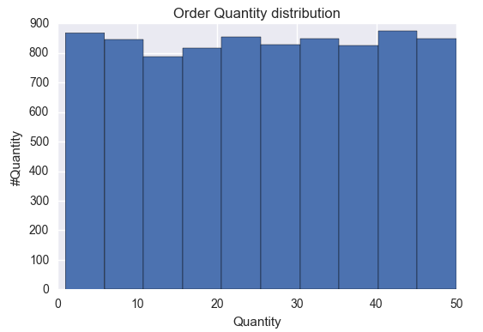
Day 4: Visualisation
Matplotlib
Histogram
fig=plt.figure()
ax = fig.add_subplot(1,1,1)
ax.hist(datastr['Order Quantity'],bins = 10)
plt.title('Order Quantity distribution')
plt.xlabel('Quantity')
plt.ylabel('#Quantity')
plt.show()

Slide 9
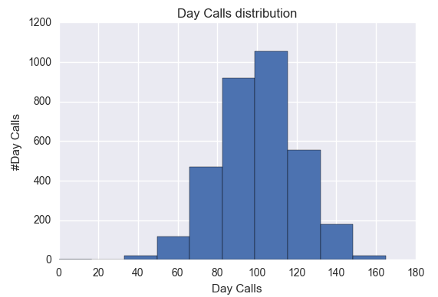
Day 4: Visualisation
Matplotlib
Histogram
fig=plt.figure()
ax = fig.add_subplot(1,1,1)
ax.hist(data2['Day Calls'],bins = 10)
plt.title('Day Calls distribution')
plt.xlabel('Day Calls')
plt.ylabel('#Day Calls')
plt.show()

Slide 10
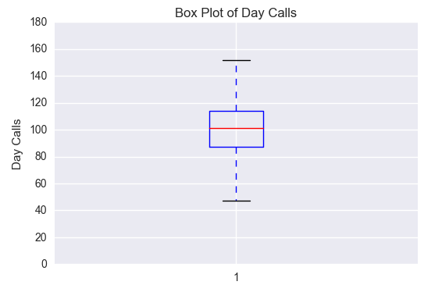
Day 4: Visualisation
Matplotlib
Boxplot
fig=plt.figure()
ax = fig.add_subplot(1,1,1)
a=np.array(data2['Day Calls'])
bp=ax.boxplot(a)
plt.ylabel('Day Calls')
plt.title('Box Plot of Day Calls')
plt.show()
Elements of a boxplot:
Box (Outline and fill), Whisker, Caps, Medians, Fliers

Slide 11
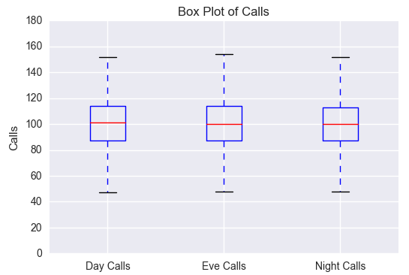
Day 4: Visualisation
Matplotlib
Boxplot
fig=plt.figure()
ax = fig.add_subplot(1,1,1)
a=np.array(data2[['Day Calls','Eve Calls','Night Calls']])
labels=['Day Calls','Eve Calls','Night Calls']
bp=ax.boxplot(a,labels=labels)
plt.ylabel('Calls')
plt.title('Box Plot of Calls')
plt.show()
Elements of a boxplot:
Box (Outline and fill), Whisker, Caps, Medians, Fliers

Slide 12
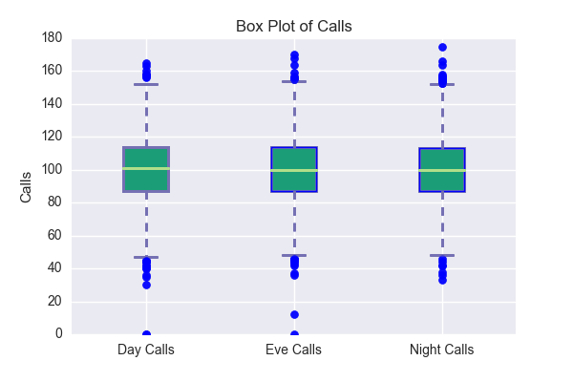
Day 4: Visualisation
Matplotlib
Boxplot
bp=ax.boxplot(a,labels=labels,patch_artist=True)
for box in bp['boxes']:
# change outline color
box.set( color='#7570b3', linewidth=2)
# change fill color
box.set( facecolor = '#1b9e77' )
## change color and linewidth of the whiskers
for whisker in bp['whiskers']:
whisker.set(color='#7570b3', linewidth=2)
## change color and linewidth of the caps
for cap in bp['caps']:
cap.set(color='#7570b3', linewidth=2)
## change color and linewidth of the medians
for median in bp['medians']:
median.set(color='#b2df8a', linewidth=2)
for flier in bp['fliers']:
flier.set(marker='o', color='#e7298a', alpha=0.5)
fig.savefig('fig1.png')
Elements of a boxplot:
Box (Outline and fill), Whisker, Caps, Medians, Fliers

Slide 13
Day 4: Visualisation
Matplotlib
Box Plot
bp=ax.boxplot(a,labels=labels,patch_artist=True)
for box in bp['boxes']:
# change outline color
box.set( color='#7570b3', linewidth=2)
# change fill color
box.set( facecolor = '#1b9e77' )
## change color and linewidth of the whiskers
for whisker in bp['whiskers']:
whisker.set(color='#7570b3', linewidth=2)
## change color and linewidth of the caps
for cap in bp['caps']:
cap.set(color='#7570b3', linewidth=2)
## change color and linewidth of the medians
for median in bp['medians']:
median.set(color='#b2df8a', linewidth=2)
for flier in bp['fliers']:
flier.set(marker='o', color='#e7298a', alpha=0.5)
fig.savefig('fig1.png')
Elements of a boxplot:
Box (Outline and fill), Whisker, Caps, Medians, Fliers

Slide 14
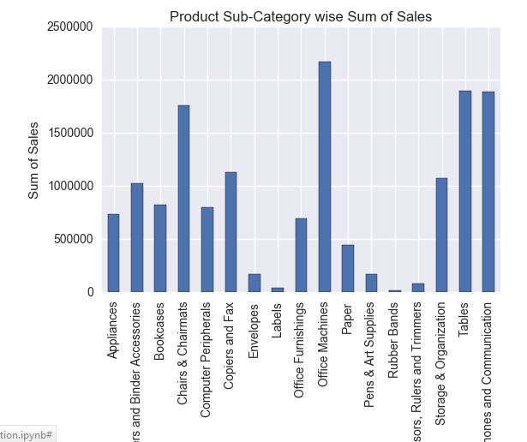
Day 4: Visualisation
Matplotlib
Bar Chart
var = datastr.groupby('Product Sub-Category').Sales.sum() #grouped sum of sales at Gender level
fig = plt.figure()
ax1 = fig.add_subplot(1,1,1)
ax1.set_xlabel('Ship Mode')
ax1.set_ylabel('Sum of Sales')
ax1.set_title("Product Sub-Category wise Sum of Sales")
var.plot(kind='bar')

Slide 15
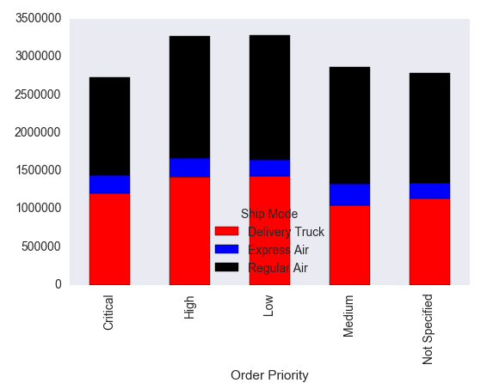
Day 4: Visualisation
Matplotlib
Bar Chart
var = datastr.groupby(['Order Priority','Ship Mode']).Sales.sum()
var.unstack().plot(kind='bar',stacked=True, color=['red','blue','black'], grid=False)

Slide 16
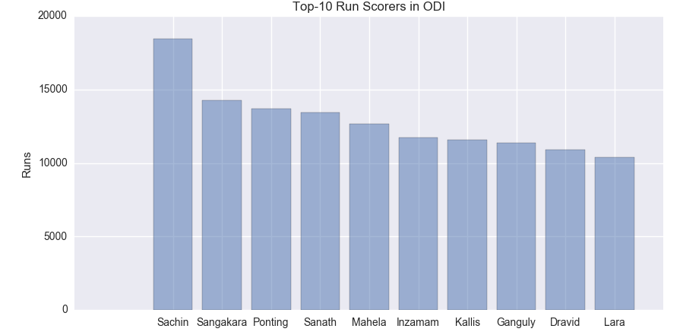
Day 4: Visualisation
Matplotlib
Bar Chart
fig = plt.figure(figsize=(10,5))
ypos=range(len(databar['Player']))
plt.bar(ypos,databar['Run'], align='center', alpha=0.5)
plt.xticks(ypos,databar['Player'])
plt.ylabel('Runs')
plt.title('Top-10 Run Scorers in ODI')
plt.show()

Slide 17
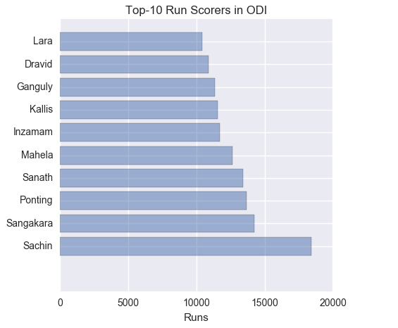
Day 4: Visualisation
Matplotlib
Bar Chart
fig = plt.figure(figsize=(10,5))
ypos=range(len(databar['Player']))
plt.bar(ypos,databar['Run'], align='center', alpha=0.5)
plt.xticks(ypos,databar['Player'])
plt.ylabel('Runs')
plt.title('Top-10 Run Scorers in ODI')
plt.show()

Slide 18
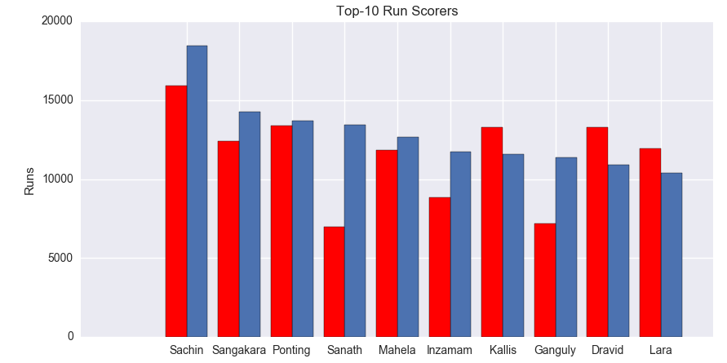
Day 4: Visualisation
Matplotlib
Bar Chart
fig= plt.figure(figsize=(10,5))
bar_width = 0.4
bar_locations = np.arange(len(databar['Player']))
plt.bar(bar_locations, databar['Run'], bar_width)
plt.bar(bar_locations-bar_width, databar['Test_Run'], bar_width, color='r')
plt.xticks(bar_locations,databar['Player'])
plt.ylabel('Runs')
plt.title('Top-10 Run Scorers')

Slide 19
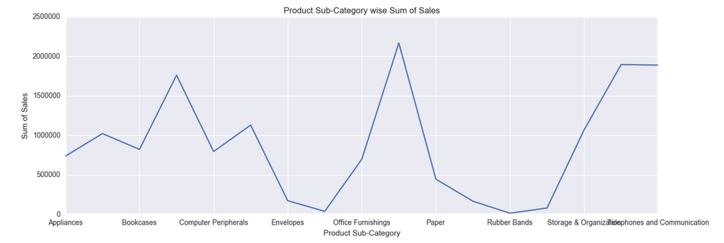
Day 4: Visualisation
Matplotlib
var = datastr.groupby('Product Sub-Category').Sales.sum() #grouped sum of sales at Gender level
fig = plt.figure(figsize=(15,5))
ax1 = fig.add_subplot(1,1,1)
ax1.set_xlabel('Ship Mode')
ax1.set_ylabel('Sum of Sales')
ax1.set_title("Product Sub-Category wise Sum of Sales")
var.plot(kind='line')
Line Chart

Slide 20
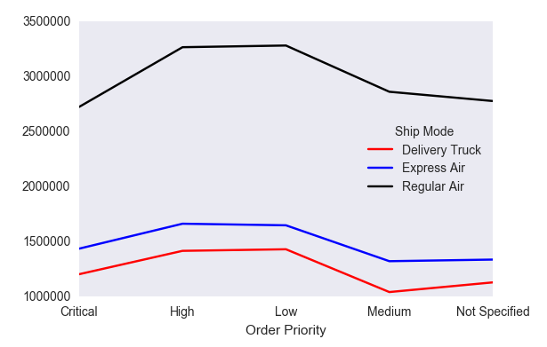
Day 4: Visualisation
Matplotlib
var = datastr.groupby(['Order Priority','Ship Mode']).Sales.sum()
var.unstack().plot(kind='line',stacked=True, color=['red','blue','black'], grid=False)
Line Chart

Slide 21
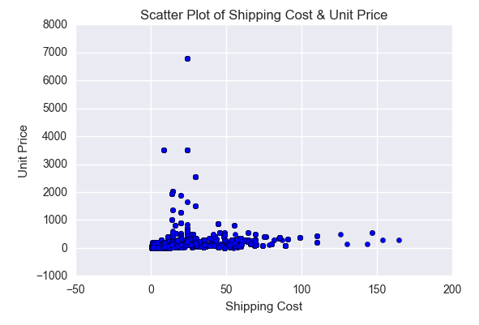
Day 4: Visualisation
Matplotlib
fig = plt.figure()
ax = fig.add_subplot(1,1,1)
ax.scatter(datastr['Shipping Cost'],datastr['Unit Price'])
ax1.set_xlabel('Shipping Cost')
ax1.set_ylabel('Unit Price')
ax1.set_title("Scatter Plot of Shipping Cost & Unit Price")
plt.show()
Scatter Plot

Slide 22
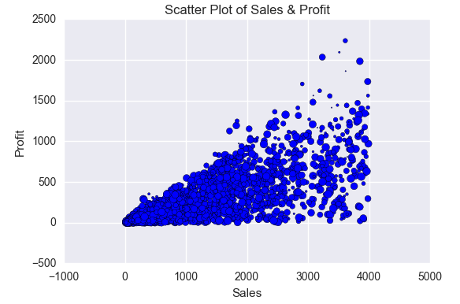
Day 4: Visualisation
Matplotlib
fig = plt.figure()
ax = fig.add_subplot(1,1,1)
datastr1=datastr[(datastr['Sales']<=4000) & (datastr['Profit']>=0)]
ax.scatter(datastr1['Sales'],datastr1['Profit'],s=datastr['Order Quantity'])
ax.set_xlabel('Sales')
ax.set_ylabel('Profit')
ax.set_title("Scatter Plot of Shipping Cost & Unit Price")
plt.show()
Scatter Plot

Slide 23
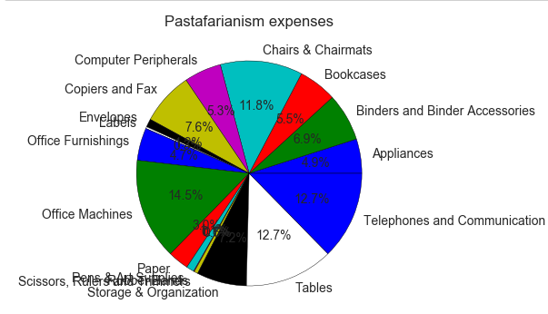
Day 4: Visualisation
Matplotlib
var=datastr.groupby(['Product Sub-Category']).sum().stack()
temp=var.unstack()
type(temp)
x_list = temp['Sales']
label_list = temp.index
plt.axis("equal") #The pie chart is oval by default. To make it a circle use pyplot.axis("equal")
#To show the percentage of each pie slice, pass an output format to the autopctparameter
plt.pie(x_list,labels=label_list,autopct="%1.1f%%")
plt.title("Product Sub-Category Pie-Chart")
plt.show()
Pie Chart

Slide 24
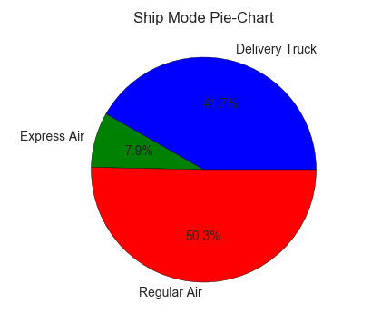
Day 4: Visualisation
Pie Chart
Matplotlib
var=datastr.groupby([‘Ship Mode']).sum().stack()
temp=var.unstack()
type(temp)
x_list = temp['Sales']
label_list = temp.index
plt.axis("equal") plt.pie(x_list,labels=label_list,autopct="%1.1f%%")
plt.title("Product Sub-Category Pie-Chart")
plt.show()

Slide 25
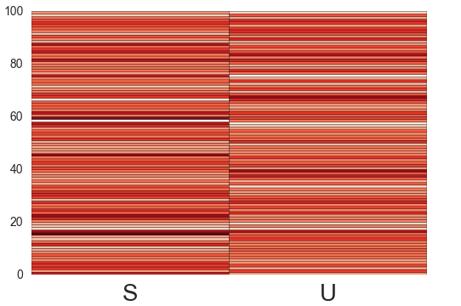
Day 4: Visualisation
Heat Map
Matplotlib
data = np.random.randn(100,2)
columns = list('SU')
fig,ax=plt.subplots()
ax.pcolor(data,cmap=plt.cm.Reds,edgecolors='k')
ax.set_xticks(np.arange(0,2)+0.5)
ax.xaxis.tick_bottom()
ax.set_xticklabels(columns,minor=False,fontsize=20)
plt.show()

Slide 26
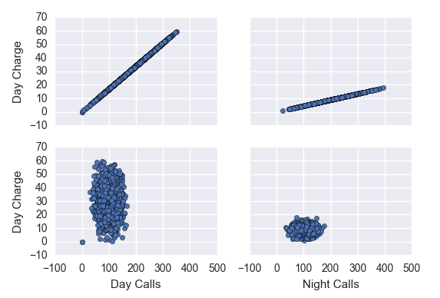
Day 4: Visualisation
Pair Plot
Matplotlib
figure,axs = plt.subplots(2, 2,sharey=True,sharex=True)
data2.plot(kind='scatter',x='Day Mins',y='Day Charge',ax=axs[0][0])
data2.plot(kind='scatter',x='Night Mins',y='Night Charge',ax=axs[0][1])
data2.plot(kind='scatter',x='Day Calls',y='Day Charge',ax=axs[1][0])
data2.plot(kind='scatter',x='Night Calls',y='Night Charge',ax=axs[1][1])

Slide 27
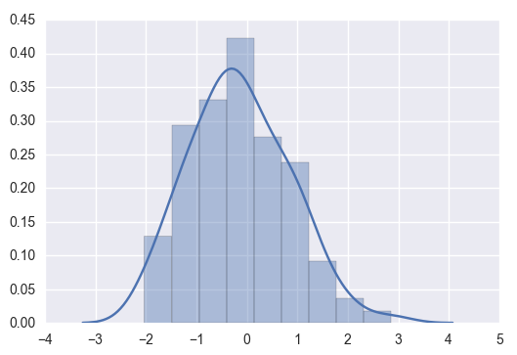
Day 4: Visualisation
Histogram (with KDE)
Seaborn
%matplotlib inline
import seaborn as sns
x = np.random.normal(size=100)
sns.distplot(x)
Blue curve is Kernel Density Estimation curve. A gaussian distribution is created centred at each observation. These distributions are summed up to give KDE.

Slide 28
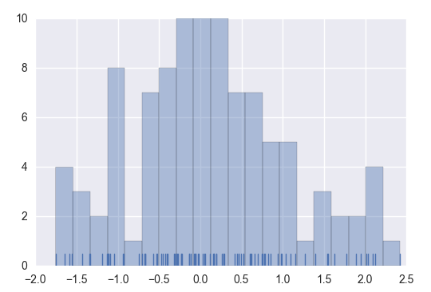
Day 4: Visualisation
Histogram (with Rug)
Seaborn
x = np.random.normal(size=100)
sns.distplot(x, bins=20, kde=False, rug=True)
There is a small blue tick corresponding to each observation. These blue ticks are called rugs.

Slide 29
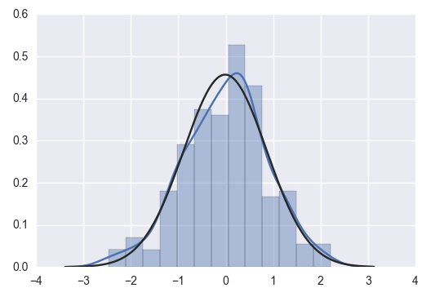
Day 4: Visualisation
Fitting a distribution
Seaborn
from scipy import stats
x = np.random.randn(200)
sns.distplot(x, kde=True, fit=stats.norm)
Blue curve is the actual KDE.
Black line is the fitted normal distribution.

Slide 30
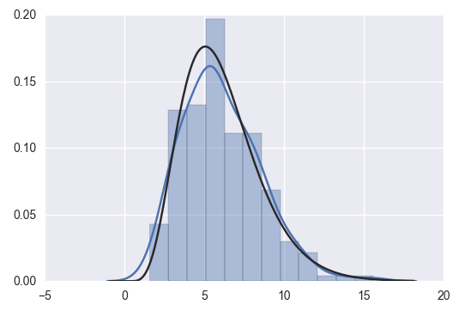
Day 4: Visualisation
Fitting a distribution
Seaborn
from scipy import stats
x = np.random.gamma(6,size=200)
sns.distplot(x, kde=True, fit=stats.gamma);
Blue curve is the actual KDE.
Black line is the fitted gamma distribution.
Gamma function is a continuous extension of factorial function
gamma(k+1)=k*gamma(k)

Slide 31
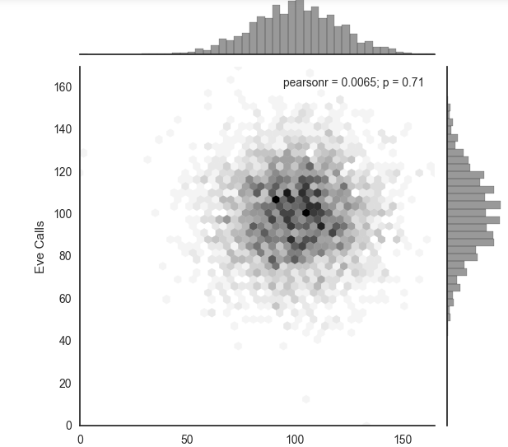
Day 4: Visualisation
Bivariate distribution (Hexbin)
Seaborn
with sns.axes_style("white"):
sns.jointplot(x=data2['Day Calls'], y=data2['Eve Calls'], kind="hex", color="k");
The whole bivariate plane is divided in hexbins. The darkness of the shade denotes the frequency in that bin.

Slide 32
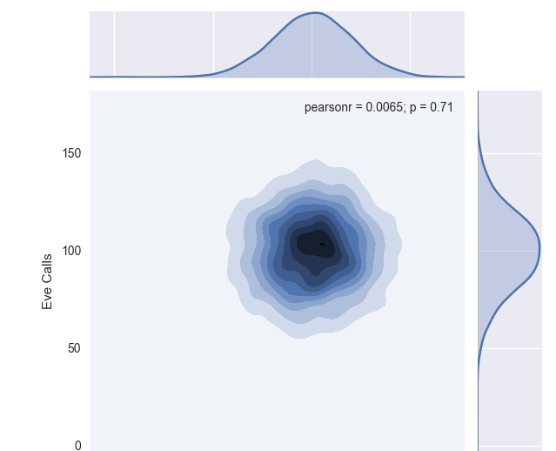
Day 4: Visualisation
Bivariate distribution (KDE)
Seaborn
sns.jointplot(x=data2['Day Calls'], y=data2['Eve Calls'], kind="kde");

Slide 33
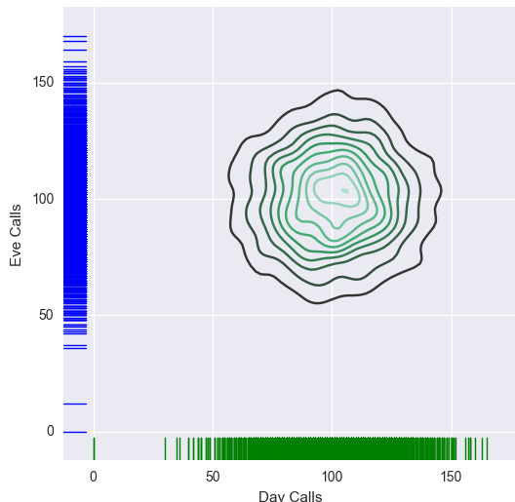
Day 4: Visualisation
Bivariate distribution (Rugplot)
Seaborn
f, ax = plt.subplots(figsize=(6, 6))
sns.kdeplot(data2['Day Calls'], data2['Eve Calls'], ax=ax)
sns.rugplot(data2['Day Calls'], color="g", ax=ax)
sns.rugplot(data2['Eve Calls'], vertical=True, ax=ax)

Slide 34
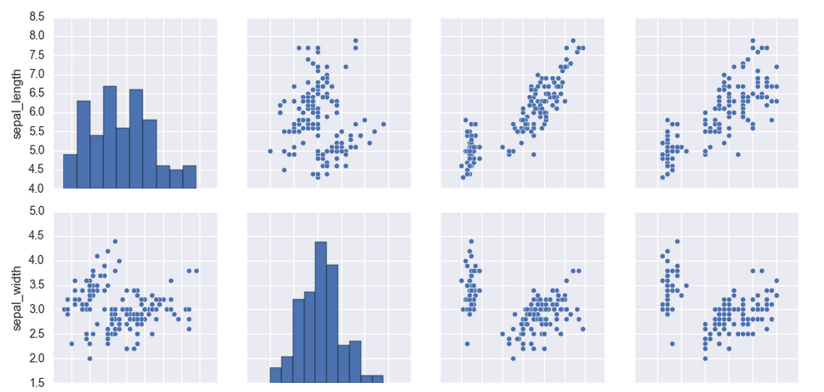
Day 4: Visualisation
Pair-wise grid plot
Seaborn
import seaborn as sns
%matplotlib inline
iris = sns.load_dataset("iris")
sns.pairplot(iris)

Slide 35
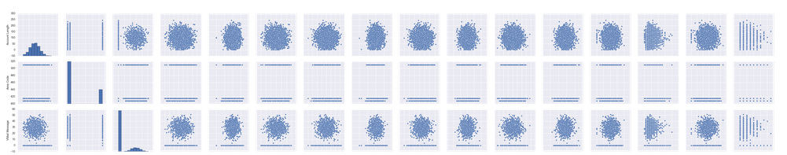
Day 4: Visualisation
Pair-wise grid plot
Seaborn
import seaborn as sns
%matplotlib inline
sns.pairplot(data2)

Slide 36
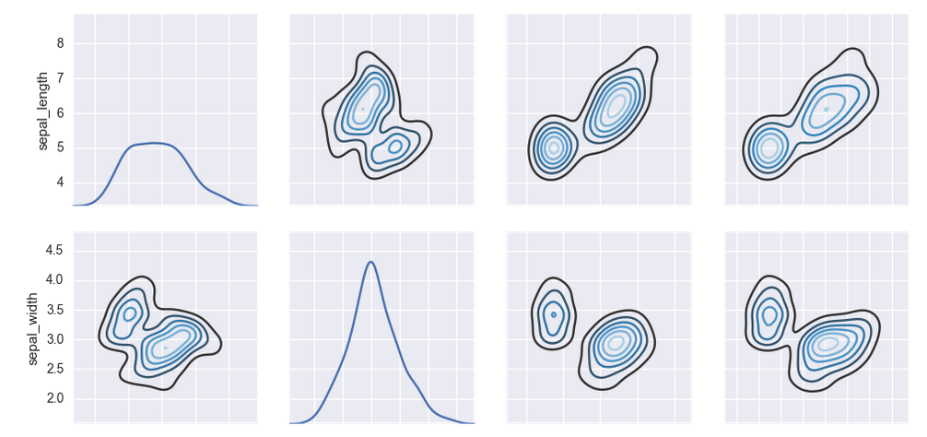
Day 4: Visualisation
Pair-wise grid plot (KDE)
Seaborn
g = sns.PairGrid(iris)
g.map_diag(sns.kdeplot)
g.map_offdiag(sns.kdeplot, cmap="Blues_d", n_levels=6)

Slide 37
Day 4: Visualisation
Importing datasets
Seaborn
titanic = sns.load_dataset("titanic")
tips = sns.load_dataset("tips")
iris = sns.load_dataset("iris")

Slide 38
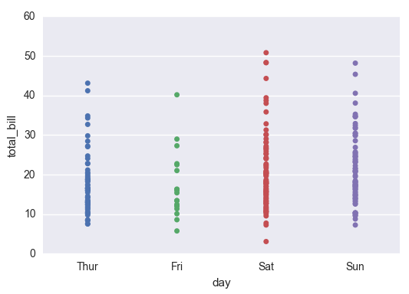
Day 4: Visualisation
Categorical Scatter plot
Seaborn
sns.stripplot(x="day", y="total_bill", data=tips)

Slide 39
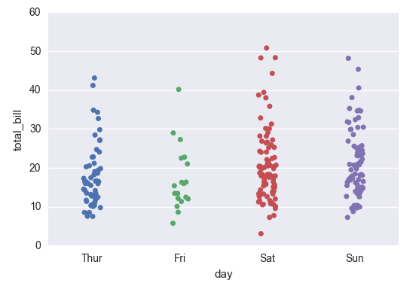
Day 4: Visualisation
Categorical Strip plot
Seaborn
sns.stripplot(x="day", y="total_bill",
data=tips, jitter=True)
Strip plot adds an element of jitter (random values) to coordinates (more on y than x) to show the overlapping points distinctly

Slide 40
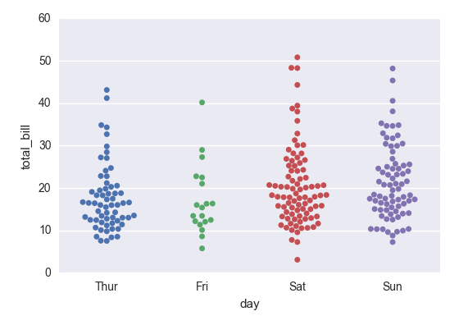
Day 4: Visualisation
Categorical Swarm plot
Seaborn
sns.swarmplot(x="day", y="total_bill",
data=tips)
Swarm plot adds an element of jitter (random values) to coordinates (more on x than y) to show the overlapping points distinctly

Slide 41
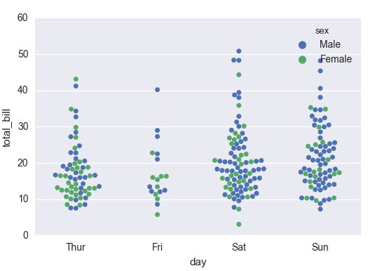
Day 4: Visualisation
Nested category Swarm plot
Seaborn
sns.swarmplot(x="day", y="total_bill",
hue="sex", data=tips)
‘hue’ option is used to give the nested caategory

Slide 42
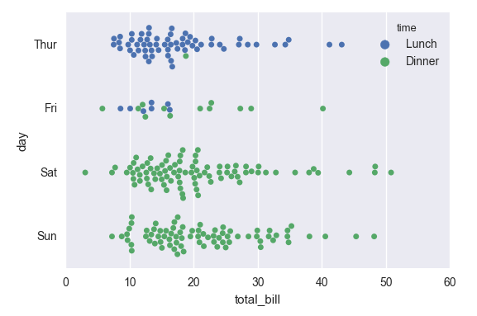
Day 4: Visualisation
Nested category Swarm plot
Seaborn
sns.swarmplot(x="total_bill", y="day",
hue="time", data=tips)
‘orient’ option is used to set the orientation of the plot or the values of x or y columns set the orientation

Slide 43
Day 4: Visualisation
Nested category Swarm plot
Seaborn
sns.swarmplot(x="total_bill", y="day",
hue="time", data=tips)
‘orient’ option is used to set the orientation of the plot or the values of x or y columns set the orientation

Slide 44
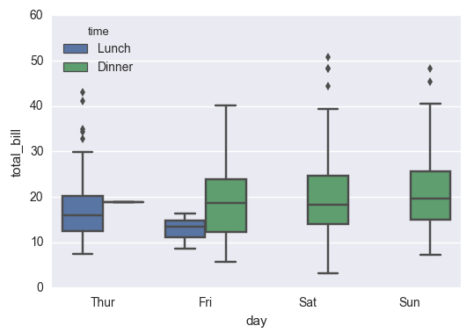
Day 4: Visualisation
Box plot
Seaborn
sns.boxplot(x="day", y="total_bill",
hue="time", data=tips)

Slide 45
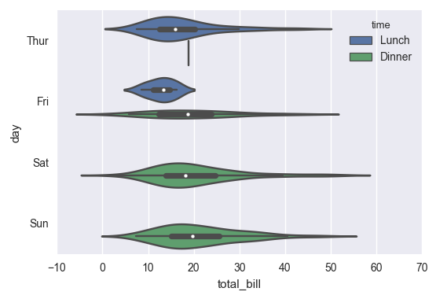
Day 4: Visualisation
Violin plot
Seaborn
sns.violinplot(x="total_bill", y="day",
hue="time", data=tips)
Violin plots include KDE to a boxplot

Slide 46
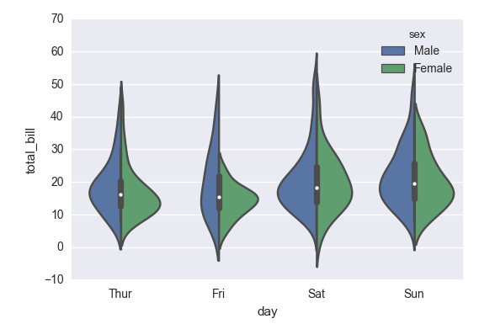
Day 4: Visualisation
Violin plot
Seaborn
sns.violinplot(x="day", y="total_bill",
hue="sex", data=tips, split=True)
Violin plot can be split if there are two categories on which to split. Box plot denotes overall distribution while the KDEs denote the distribution for respective categories.

Slide 47
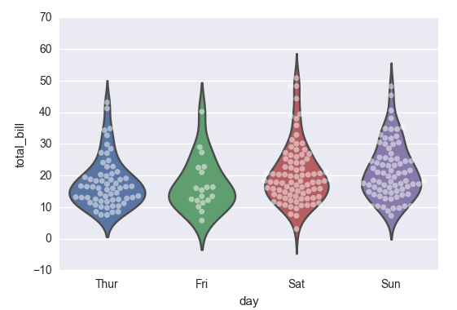
Day 4: Visualisation
Violin plot
Seaborn
sns.violinplot(x="day", y="total_bill",
data=tips, inner=None)
sns.swarmplot(x="day", y="total_bill",
data=tips, color="w", alpha=.5)
Swarm plots can be combined with violin plots or box plots

Slide 48
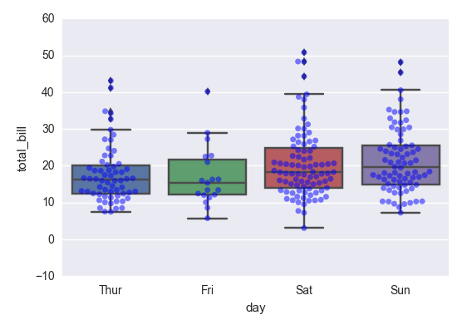
Day 4: Visualisation
Box plot
Seaborn
sns.boxplot(x="day", y="total_bill",
data=tips)
sns.swarmplot(x="day", y="total_bill",
data=tips, color="b", alpha=.5)
Swarm plots can be combined with violin plots or box plots

Slide 49
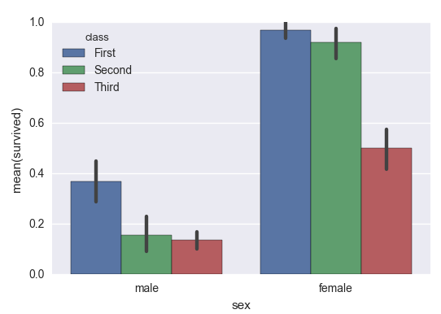
Day 4: Visualisation
Bar plot
Seaborn
sns.barplot(x="sex", y="survived",
hue="class", data=titanic)

Slide 50
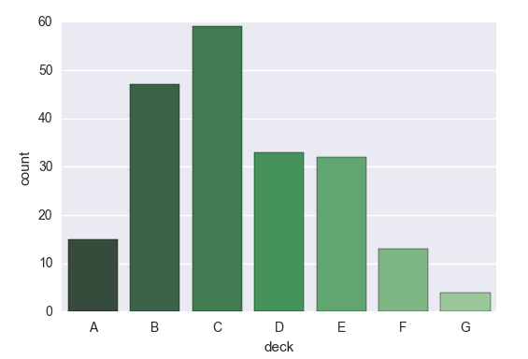
Day 4: Visualisation
Count plot
Seaborn
sns.countplot(x="deck", data=titanic,
palette="Greens_d")
Count plot just gives the count for that category

Slide 51
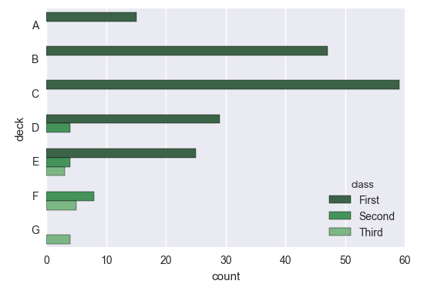
Day 4: Visualisation
Count plot
Seaborn
sns.countplot(y="deck", hue="class",
data=titanic, palette="Greens_d")

Slide 52
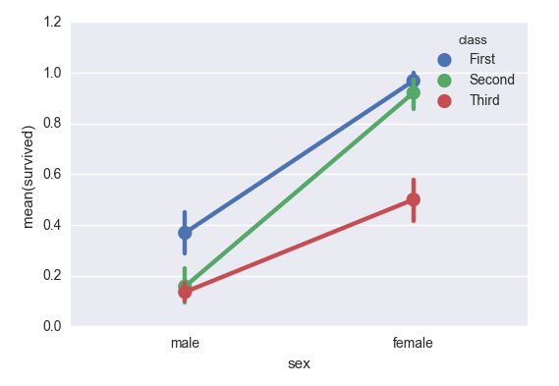
Day 4: Visualisation
Point plot
Seaborn
sns.pointplot(x="sex", y="survived",
hue="class", data=titanic)
Instead of bars, point plots have points and the confidence of interval for mean estimation.

Slide 53
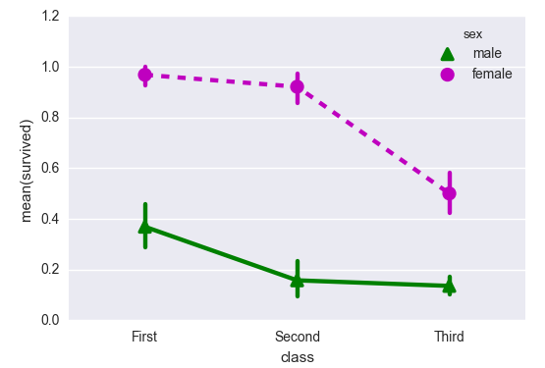
Day 4: Visualisation
Point plot
Seaborn
sns.pointplot(x="class", y="survived",
hue="sex", data=titanic,
palette={"male": "g", "female": "m"},
markers=["^", "o"], linestyles=["-", "--"])
Providing line styling options

Slide 54
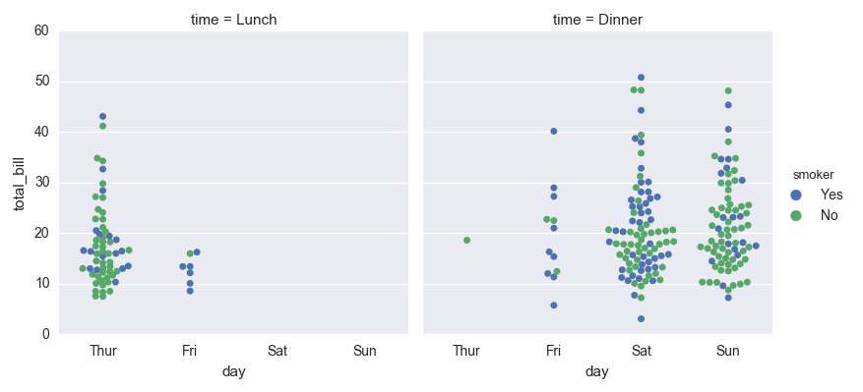
Day 4: Visualisation
Multi-panel plot
Seaborn
sns.factorplot(x="day", y="total_bill",
hue="smoker",col="time", data=tips,
kind="swarm")
Factorplot is used to craete muli-panel plots. It produces a pair plot object.

Slide 55
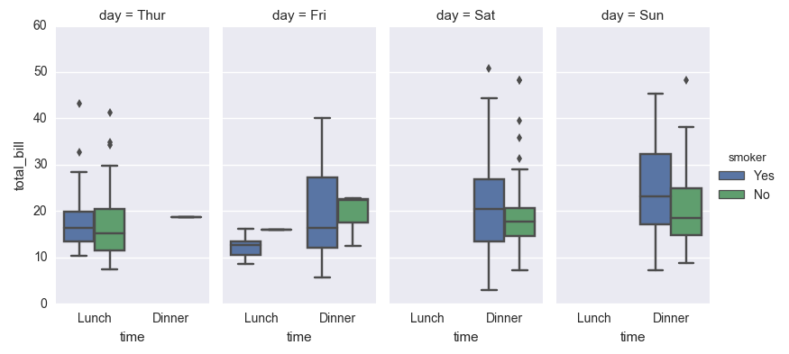
Day 4: Visualisation
Multi-panel plot
Seaborn
sns.factorplot(x="time", y="total_bill",
hue="smoker",col="day", data=tips,
kind="box", size=4, aspect=.5)
Size-vertical size; Aspect-horizontal size

Slide 56
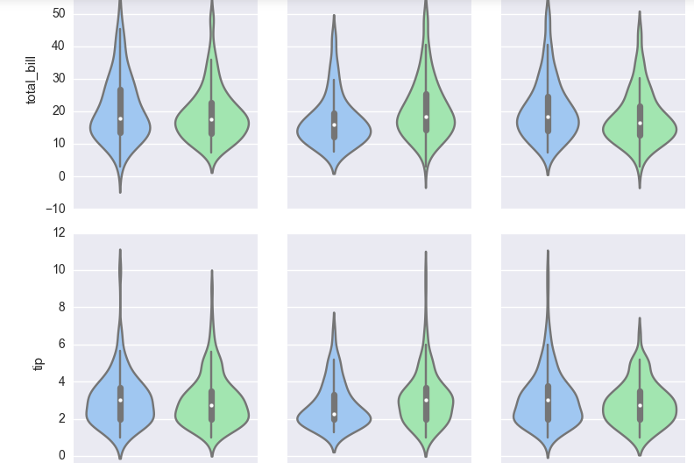
Day 4: Visualisation
Multi-panel plot
Seaborn
g = sns.PairGrid(tips, x_vars=["smoker",
"time", "sex"],y_vars=["total_bill", "tip"],
aspect=.75, size=3.5)
g.map(sns.violinplot, palette="pastel")
Map and PairGrid can be combined to produce multi-panel plots for different variables across x and y axis

Slide 57

Day 4: Visualisation
Fitting a regression plot
Seaborn
sns.regplot(x="total_bill", y="tip", data=tips)
Returns the regression fit line with a 95% confidence area. Regplot accepts numpy arrays and series as well, lmplot doesn’t.

Slide 58

Day 4: Visualisation
Fitting a regression plot
Seaborn
sns.lmplot(x="total_bill", y="tip", data=tips)
Returns the regression fit line with a 95% confidence area. Regplot accepts numpy arrays and series as well, lmplot doesn’t.

Slide 59

Day 4: Visualisation
Fitting a regression plot
Seaborn
sns.lmplot(x="size", y="tip", data=tips)
Fit for categorical variable. Jitter can be added for better visualisation of overlapping points

Slide 60

Day 4: Visualisation
Fitting a regression plot
Seaborn
sns.lmplot(x="total_bill", y="tip",
hue="smoker", data=tips)
Different regression for different categories

Slide 61

Day 4: Visualisation
Fitting a regression plot
Seaborn
sns.lmplot(x="total_bill", y="tip",
hue="smoker", data=tips,
markers=["o", "x"], palette="Set1")
Different regression for different categories. Specifying styling parameters.

Slide 62

Day 4: Visualisation
Fitting a regression plot
Seaborn
sns.lmplot(x="total_bill", y="tip",
hue="smoker", col="time", data=tips)
Different regression for different categories

Slide 63

Day 4: Visualisation
Fitting a regression plot
Seaborn
sns.lmplot(x="total_bill", y="tip",
hue="smoker",col="time", row="sex",
data=tips))

Slide 64

Day 4: Visualisation
Fitting a regression plot
Seaborn
sns.lmplot(x="size", y="tip", data=tips,
x_estimator=np.mean)
Instead of all observation, they can be replaced by the mean value.

Slide 65

Day 4: Visualisation
Fitting a regression plot
Seaborn
anscombe = sns.load_dataset("anscombe")
sns.lmplot(x="x", y="y",
data=anscombe.query("dataset == 'II'"),
ci=None, scatter_kws={"s": 80})
Linear fitting doesn’t work all the time.

Slide 66

Day 4: Visualisation
Fitting a regression plot
Seaborn
sns.lmplot(x="x", y="y",
data=anscombe.query("dataset == 'II'"),
order=2, ci=None, scatter_kws={"s": 80})
Fitting an order 2 polynomial.

Slide 67

Day 4: Visualisation
Fitting a regression plot
Seaborn
sns.lmplot(x="x", y="y",
data=anscombe.query("dataset == 'III'"),
ci=None, scatter_kws={"s": 80})
Taking care of outliers.

Slide 68

Day 4: Visualisation
Fitting a regression plot
Seaborn
sns.lmplot(x="x", y="y",
data=anscombe.query("dataset == 'III'"),
robust=True, ci=None, scatter_kws={"s": 80})
Robust uses a different method to downweight observations with large residuals.

Slide 69

Day 4: Visualisation
Fitting a regression plot
Seaborn
tips["big_tip"] = (tips.tip / tips.total_bill) > .15
sns.lmplot(x="total_bill", y="big_tip",
data=tips,y_jitter=.03)
Taking care of binary outcome variables using Logistic regression

Slide 70

Day 4: Visualisation
Fitting a regression plot
Seaborn
sns.residplot(x="x", y="y",
data=anscombe.query("dataset == 'I'"),
scatter_kws={"s": 80})
Residual plot

Slide 71
Day 4: Visualisation
What is Plotly
Plotly
What is Plotly?
Plotly is one of the finest data visualization tools available built on top of visualization library D3.js, HTML and CSS.
It is created using Python and the Django framework. One can choose to create interactive data visualizations online or use the libraries that plotly offers to create these visualizations in the language/ tool of choice.
It is compatible with a number of languages/ tools: R, Python, MATLAB, Perl, Julia, Arduino.

Slide 72
Day 4: Visualisation
What is Plotly
Plotly
Advantages of Plotly?
interactive visualizations built using D3.js without even having to know D3.js.
compatible with number of different languages/ tools like R, Python, MATLAB, Perl, Julia, Arduino.
interactive plots can easily be shared online with multiple people.
can also be used by people with no technical background for creating interactive plots by uploading the data and using plotly GUI.
is compatible with ggplots in R and Python.
allows to embed interactive plots in projects or websites using iframes or html.
The syntax for creating interactive plots using plotly is very simple as well.

Slide 73
Day 4: Visualisation
What is Plotly
Plotly
Dis-advantages of Plotly?
The plots made using plotly community version are always public and can be viewed by anyone.
For plotly community version, there is an upper limit on the API calls per day.
There are also limited number of color Palettes available in community version which acts as an upper bound on the coloring options.

Slide 74
Day 4: Visualisation
What is Plotly
Plotly
Setting up Plotly
Creating the config file using username and api_key
ply.tools.set_credentials_file(username="ashishkbt08b004", api_key="TouLrUCTQNoVpWk0OO3g")
Signing in using the credentials
py.sign_in("ashishkbt08b004", "TouLrUCTQNoVpWk0OO3g")
Importing the required packages
import plotly.plotly as py
import plotly as ply
import plotly.graph_objs as go

Slide 75

Day 4: Visualisation
What is Plotly
Plotly
Setting up Plotly
Obtaining username and api_key
1.
2.
Select ‘Settings’ from the drop down
3.

Slide 76

Day 4: Visualisation
Line Chart
Plotly
trace1=go.Scatter(x=[1,2],y=[1,2])
trace2=go.Scatter(x=[1,2],y=[2,1])
py.iplot([trace1,trace2])
The charts can be invoked from the code and then edited using the web interface

Slide 77

Day 4: Visualisation
Line Chart
Plotly
trace1=go.Scatter(name='ODI_Run',
x=databar['Player'],y=databar['Run'])
trace2=go.Scatter(name='Test_Run',
x=databar['Player'],y=databar['Test_Run'])
py.iplot([trace1,trace2])

Slide 78


Day 4: Visualisation
Save/Export/Embed
Plotly
Click on the ‘SAVE’ button
2.Choose Public, Private or Link
3. Choose from the Options below
4. Choose from the Options below
Go to the embedding tutorial

Slide 79

Day 4: Visualisation
Bar Chart
Plotly
trace1=go.Bar(name='ODI_Run',
x=databar['Player'],y=databar['Run'])
trace2=go.Bar(name='Test_Run',
x=databar['Player'],y=databar['Test_Run'])
py.iplot([trace1,trace2])

Slide 80

Day 4: Visualisation
Bar Chart
Plotly
trace1=go.Bar(name='ODI_Run',x=databar['Player'],y=databar['Run'])
trace2=go.Bar(name='Test_Run',x=databar['Player'],y=databar['Test_Run'])
layout = go.Layout(
title='ODI and Test Runs by Players',
xaxis=dict(
title='Players',
titlefont=dict(
family='Courier New, monospace',
size=18,
color='#7f7f7f'
)
),
yaxis=dict(
title='Runs',
titlefont=dict(
family='Courier New, monospace',
size=18,
color='#7f7f7f'
)
)
)
data=[trace1,trace2]
fig = go.Figure(data=data, layout=layout)
py.iplot(fig)
Providing the chart and axes titles

Slide 81

Day 4: Visualisation
Heat Map
Plotly
import numpy as np
a=np.random.randn(200).reshape(50,4)
trace=go.Heatmap(z=a)
py.iplot([trace])

Slide 82

Day 4: Visualisation
Bar Chart
Plotly
trace1=go.Scatter(name='ODI_Run',
x=databar['Player'],y=databar['Run'],
fill='tonexty')
trace2=go.Scatter(name='Test_Run',
x=databar['Player'],y=databar['Test_Run'],
fill='tonexty')
py.iplot([trace1,trace2])

Slide 83

Day 4: Visualisation
Box Plot
Plotly
tips=pd.DataFrame(tips)
trace=[go.Box(y=tips[tips['day']=='Sun']['total_bill'],
name='Sun'),
go.Box(y=tips[tips['day']=='Sat']['total_bill'],
name='Sat'),
go.Box(y=tips[tips['day']=='Thur']['total_bill'],
name='Thur'),
go.Box(y=tips[tips['day']=='Fri']['total_bill'],
name='Fri')]
fig = go.Figure(data=trace)
py.iplot(fig)

Slide 84
Day 4: Visualisation
Posting a chart online
Plotly
import plotly
plotly.plotly.plot(fig)
plotly.plotly.plot(trace)

Slide 85

Day 4: Visualisation
Time Series Plot
Plotly
data = [go.Scatter(x=dataprecip.ix[:,0],
y=dataprecip.ix[:,1])]
layout = go.Layout(
title='Monthly Precipitation (in mm), Eastport,
USA - Time Series Plot',
xaxis=dict(title='Time'),
yaxis=dict(title='Precipitation'))
fig = go.Figure(data=data, layout=layout)
py.iplot(fig)
The plots can be zoomed in by selecting to look at some time frames closely. Give a demo of this.

Slide 86

Day 4: Visualisation
3D Surface Plot
Plotly
volcano_data=pd.read_csv('volcano.csv')
data = [go.Surface(z=volcano_data.as_matrix())]
fig = go.Figure(data=data)
py.iplot(fig)

Slide 87

Day 4: Visualisation
3D Scatter Plot
Plotly
data = [go.Scatter3d(x = data2['Day Calls'],
y = data2['Eve Calls'],z = data2['Night Calls'],
mode = 'markers',
marker=dict(color = data2['Area Code']))]
fig = go.Figure(data=data)
py.iplot(fig)

Slide 88
Day 4: Visualisation
Creating graphs using Plotly UI
Plotly
Go to Plotly web UI and create a chart

Slide 89
Day 4: Visualisation
Comparison
Tool | Package
Matplotlib | A lot of options to customise the plot with a lot of plot options
Seaborn | Emphasis on statistical and categorical plots. Quality better than matplotlib.
Plotly | Highly interactive. Capability to zoom in. Publishable on web.

